Slide 1
ServiceNow Internal Training
For ECG End Users

Slide 2
Agenda
Overview
How to access ServiceNow via Self Service and Portal
Queue
New Service Catalog items
Change Request
Incident
Project
Knowledge
Chat

Slide 3
Overview
ServiceNow is scheduled to replace the current ESMT process.
ServiceNow will be used for ordering supplies, submitting change request and incident, and a knowledge database that will have documents to assist everyone.
Service Catalog enables you to view and order items from departments within your organization.
When an item is ordered, the base system generates a request to track the order and displays a summary that includes the order status in the Stage column:

Slide 4
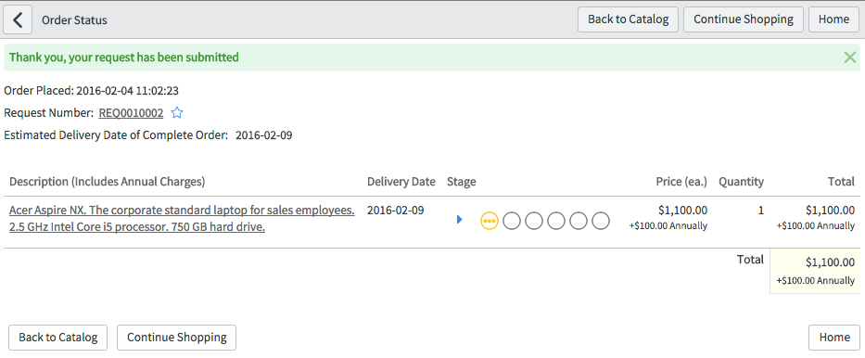
ServiceNow Overview
This will provide you with the status of your request
Service Catalog Request Status

Slide 5
How to access ServiceNow Self Service and Portal
Service now can be access via servicenow catalog or the servicenow portal
Service Catalog enables you to view and order items from departments within your organization.
These catalog items can include goods, services, and information.
Anything that can be ordered individually can be ordered as a catalog item. Anything that only exists as a part of a larger whole cannot be a catalog item. For example, a laptop can be a catalog item, but a high-resolution display for a laptop cannot.
After placing an order, the customer can track its progress. Predefined groups follow a series of tasks to deliver the item, based on a fulfillment process, including any approvals required.

Slide 6
Queue
Currently we have 55 queues in our organization. In the ECG portal there is a document that shows all the names, owners, and services being offered. Link to the listing of queue names

Slide 7
Change Request
Insert workflow diagram

Slide 8
Incident
Insert workflow diagram

Slide 9
Project
Insert workflow diagram

Slide 10
Knowledge
Insert workflow diagram

Slide 11
Knowledge
Create knowledge articles
If you have the required permissions for a knowledge base, you can create articles for it. You can create articles from the Self-Service application menu or by importing Word documents.
You can also create knowledge articles from incidents and problems.
Search for knowledge articles
From the Knowledge homepage, you can select a knowledge base to search for articles and answers. You can view only the knowledge bases to which you have access.

Slide 12
Chat
Connect Chat is a real-time messaging tool that enables users to chat with individuals and groups, quickly share files, and collaborate on any record by connecting with the right people instantly.
Features include:
Direct conversations between two users.
Group conversations between three or more users.
Conversations linked to records. Comments and work notes appear in conversations in real time and users can update the record directly from the conversation.
Drag-and-drop sharing of links, files, and records.

Slide 13
Chat Feature
Click the create link at the bottom of the window.
Enter the room details as you would for a chat room.
Click Create Room. An email notification is sent and appears in the favorites list for all invited users (the assignment group and the watch list, if selected, and additional invited users).
In the New Room Created message, click Join Room.A new chat window opens on your chat desktop.
All invited users are listed in the chat member list. Invited users that are not currently participating in the chat are listed in gray.

